Slide 1



CAPSTONE PROJECT
PROJECT TITLE
PRESENTED BY : STUDENT NAME: COLLEGE NAME: DEPARTMENT: EMAIL ID:

Slide 2
OUTLINE:
Problem Statement (Should not include solution)
Proposed System/Solution
System Development Approach (Technology Used)
Algorithm & Deployment
Result (Output Image)
Conclusion
Future Scope
References

Slide 3
PROBLEM STATEMENT:
Increasing energy consumption and waste generation in smart cities
Difficulty in predicting future demand
Lack of proper visualization for decision-making
Need for sustainable resource management

Slide 4
PROPOSED SOLUTION
.
The system uses Artificial Intelligence and Machine Learning to analyze sustainability data such as energy consumption, waste generation, and renewable energy usage.
A structured dataset is created and processed using Python libraries (Pandas, NumPy) for accurate analysis.
Data preprocessing techniques like cleaning, normalization, and feature selection are applied to improve model performance.
Multiple machine learning models such as Linear Regression, Random Forest, and Decision Tree are used to predict future energy consumption and identify patterns.
K-Means Clustering is applied to categorize regions into different sustainability levels (Low, Medium, High).
A custom Sustainability Index is developed using weighted environmental factors to measure overall performance.
The system performs predictive analytics to forecast future trends (up to 2035), helping in better planning and resource allocation.
A Power BI dashboard is designed to visualize insights like city-wise comparison, yearly trends, and KPI indicators.
The solution provides smart recommendations, such as improving waste management and increasing renewable energy usage.
Overall, the system supports data-driven decision making for smart city development and sustainable resource management.

Slide 5
SYSTEM APPROACH:
Python Used as the main programming language for data analysis, machine learning, and overall project development due to its simplicity and powerful libraries.
Pandas Used for data manipulation and preprocessing such as handling missing values, filtering data, and organizing datasets into structured formats.
NumPy Used for numerical computations, array operations, and improving performance of mathematical calculations in the dataset.
Scikit-learn Used to implement machine learning models like Linear Regression, Random Forest, Decision Tree, and K-Means Clustering for prediction and analysis.
Power BI Used to create interactive dashboards and visualizations such as charts, graphs, KPI indicators, and reports for better understanding of data insights.
Google Colab Used as a cloud-based platform to write and execute Python code, train models, and manage datasets without requiring local setup.
Machine Learning Techniques Applied supervised and unsupervised learning methods for prediction, classification, and clustering of sustainability data.
Data Visualization Tools Used charts, graphs, and dashboards to represent complex data in an easy-to-understand visual format.

Slide 6
ALGORITHM & DEPLOYMENT:
Random Forest Regression Used for better accuracy by handling complex patterns in data.
Decision Tree Used for prediction and understanding decision rules in sustainability data.
K-Means Clustering Used to group data into Low, Medium, and High sustainability zones.
Linear Regression Used to predict energy consumption based on past data (basic model).

Slide 7
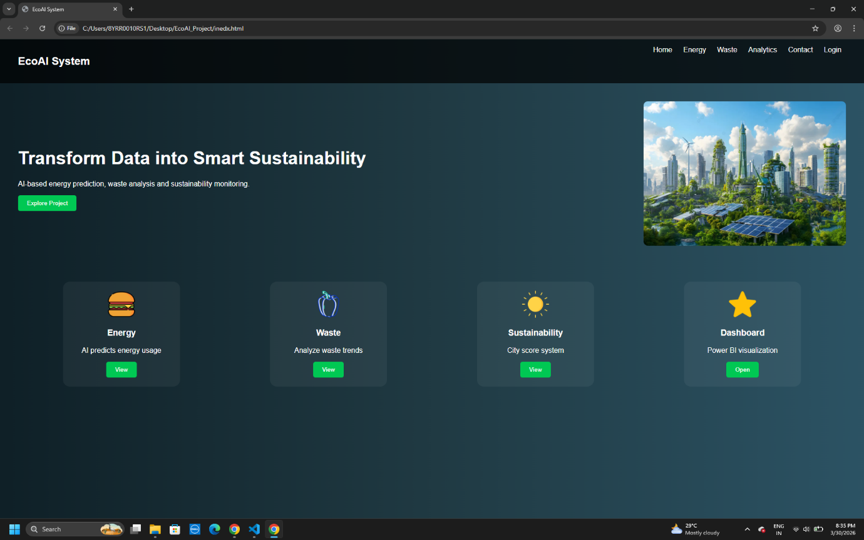
RESULT:

Slide 8
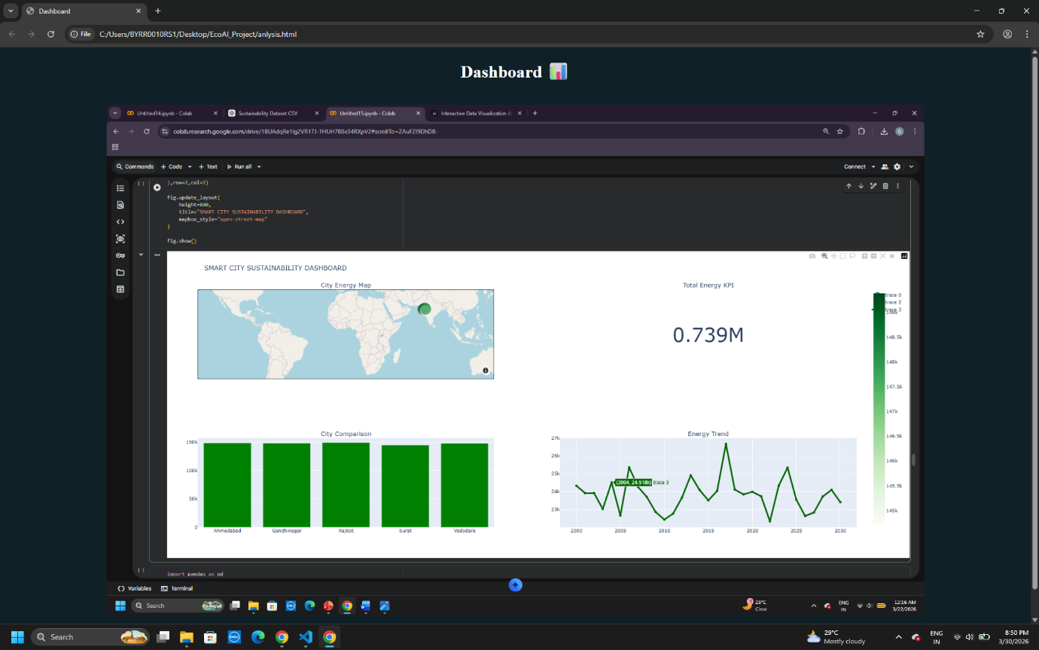

Slide 9
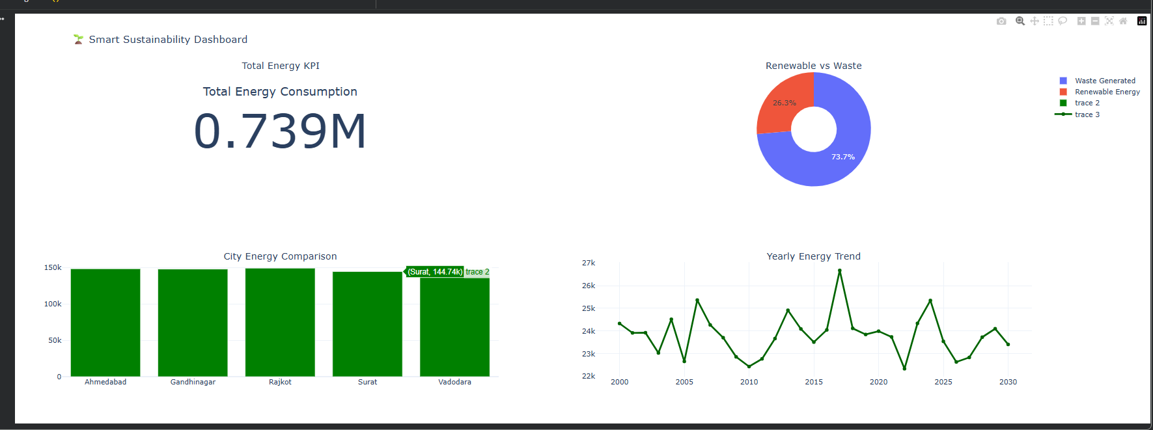

Slide 10
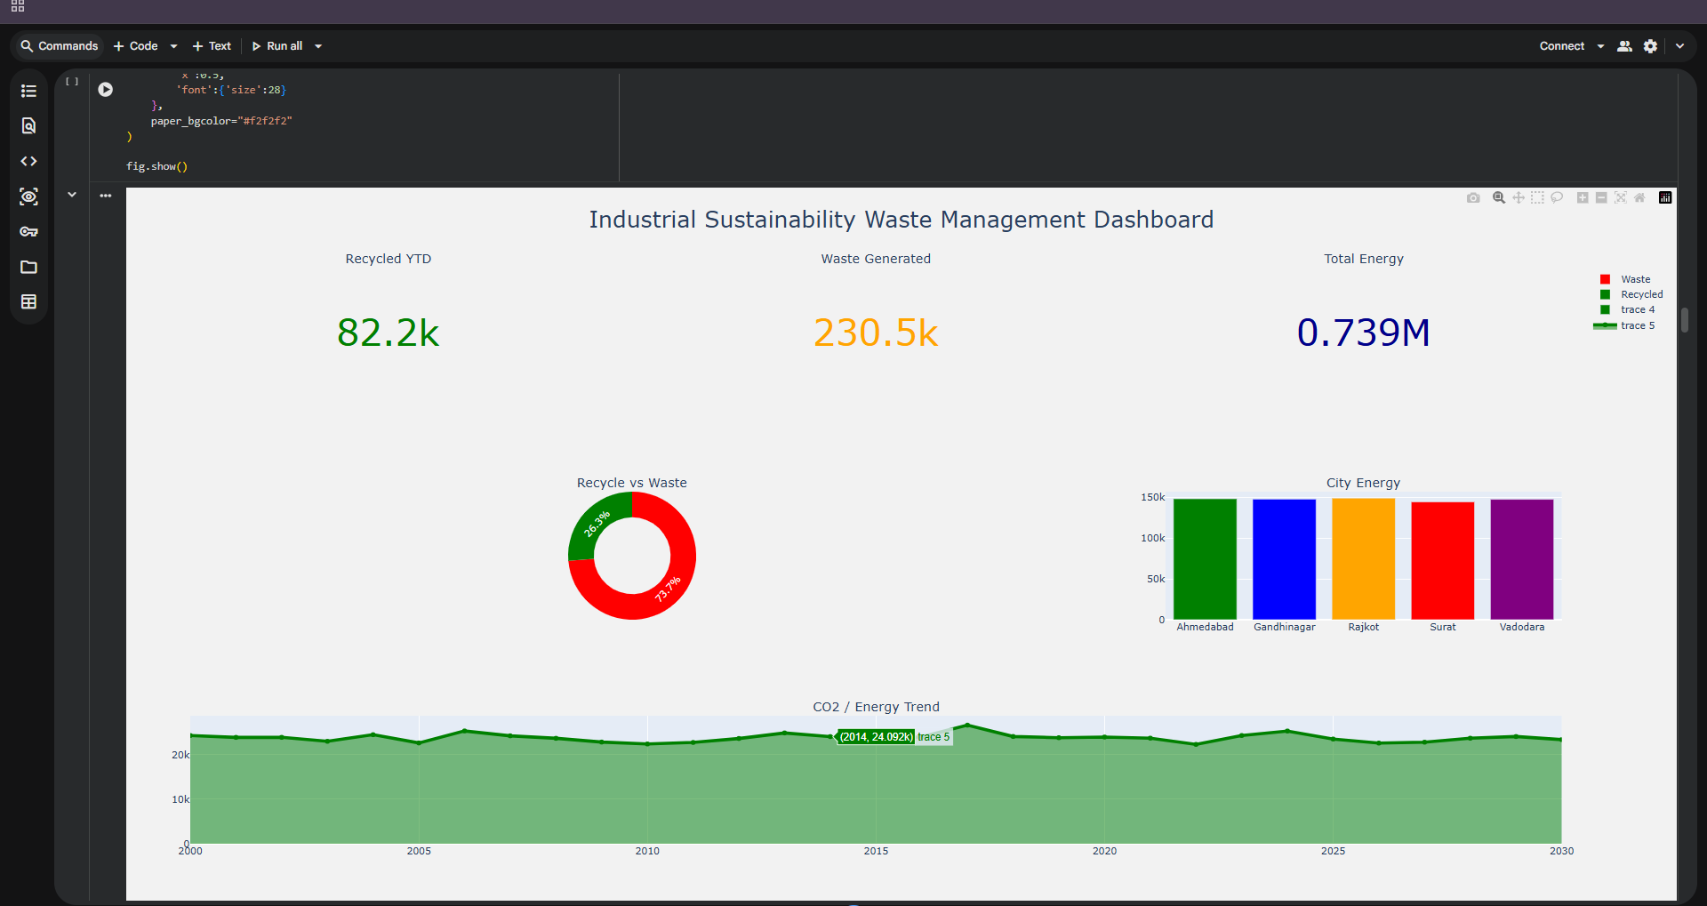

Slide 11
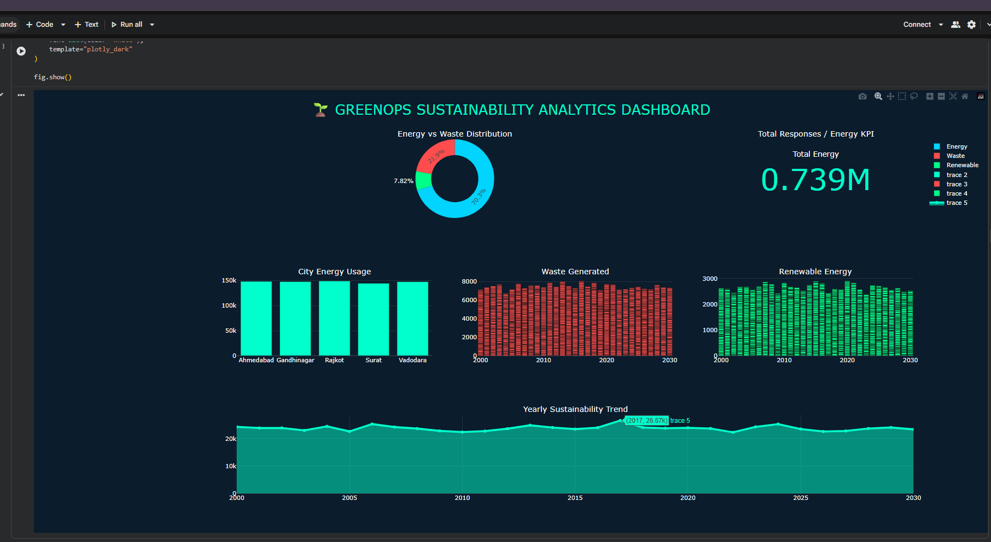

Slide 12
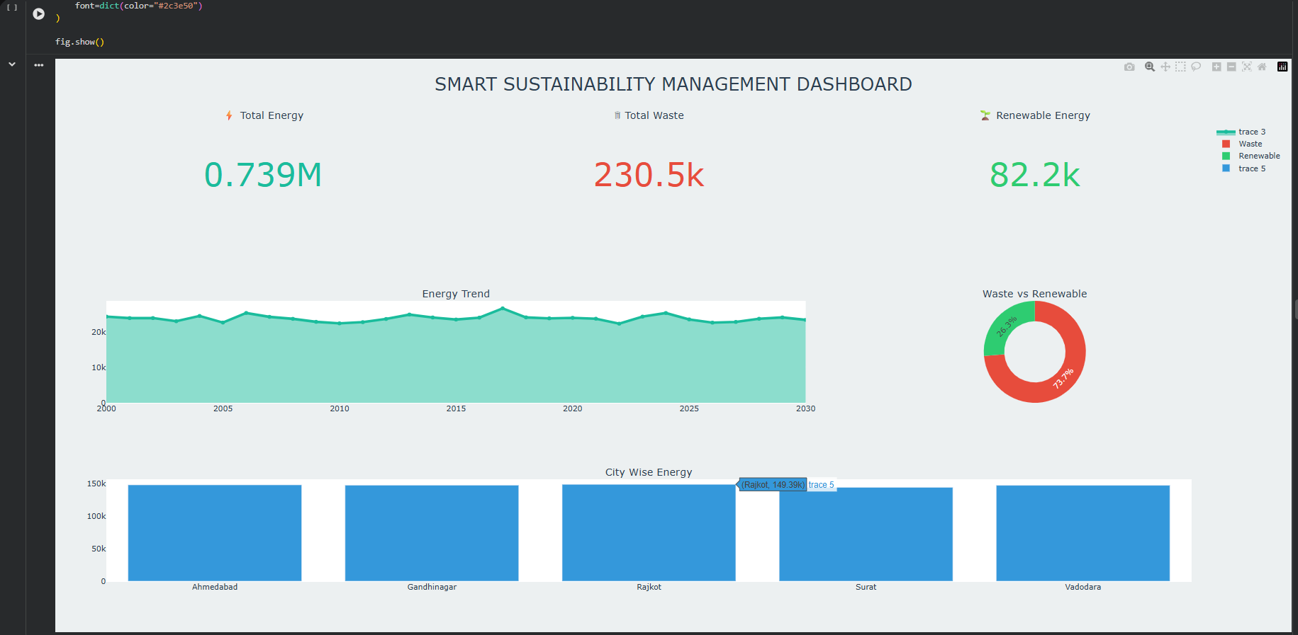

Slide 13
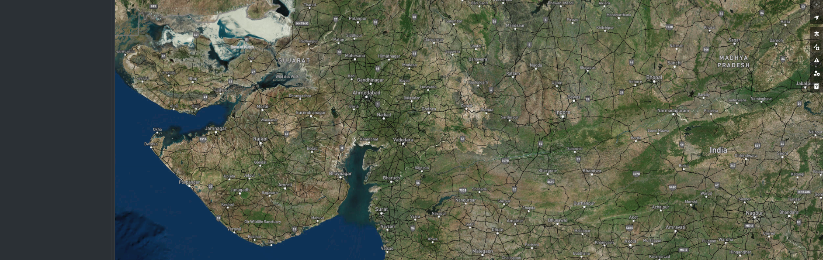

Slide 14
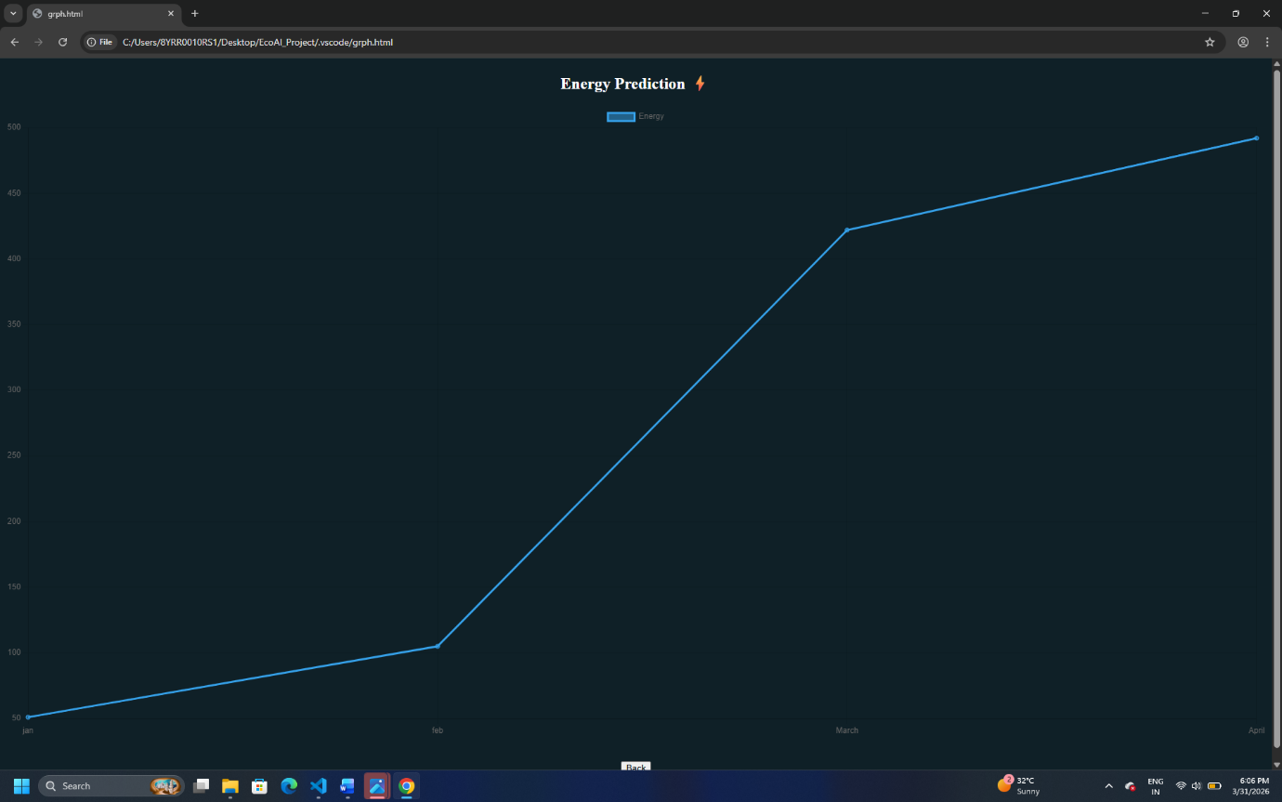

Slide 15
CONCLUSION:
AI helps in sustainability analysis
Prediction improves planning
Visualization helps decision-making
Useful for smart cities

Slide 16
FUTURE SCOPE:
Add real-time IoT data
Improve ML models
Deploy as web app
Expand to multiple cities

Slide 17
REFERENCES:
Python Libraries
Power BI
Machine Learning concepts
Dataset (Generated using Python)
GitHub Link: Link
Dataset :

Slide 18
Thank You

